Slide 1


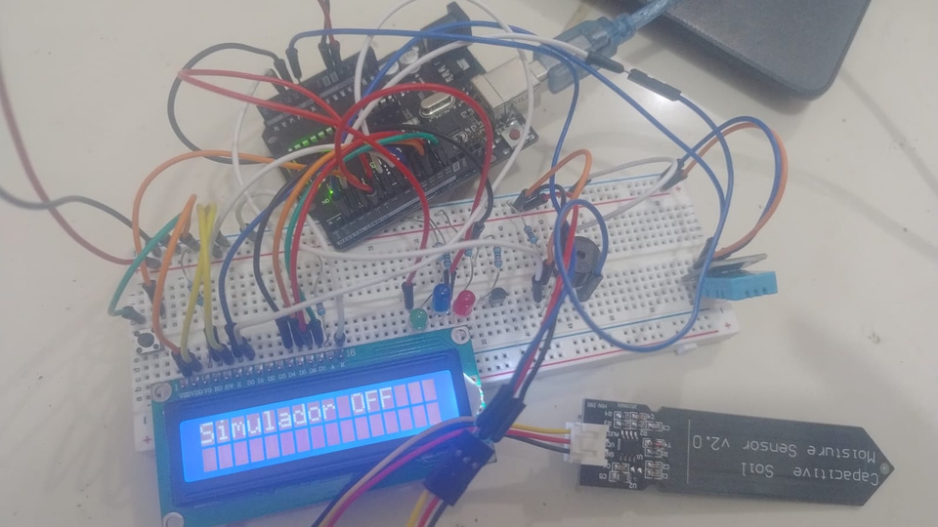
CCN
OPEN SYSTEM NETWORK FOR ATMOSPHERIC MONITORING OF THE NICOLAS CHRISTIAN SCHOOL
PROJECT:
A project for the analysis of climatic temperatures
NicoNautas

Slide 2
CCN
IDENTIFIED PROBLEM
Abrupt climatic changes have been observed, such as a heavy rains, droughts, and extreme heat waves, which impact both the Earth´s surface and daily life. These phenomena cause soil erosion, affecting ecosystem stability and the availability of resources.
NicoNautas

Slide 3
CCN
It analyzes the surface´s climatic conditions.
This device operates through the use of actuators and sensors.
PROJECT DETAILS.
The project aims to foster awareness of climate change.
The tools used in this project are: The UNO R3 board from the ELEGO package (hardware), the opensource C++ programming language, and the Arduino IDE development (software).
NicoNautas

Slide 4
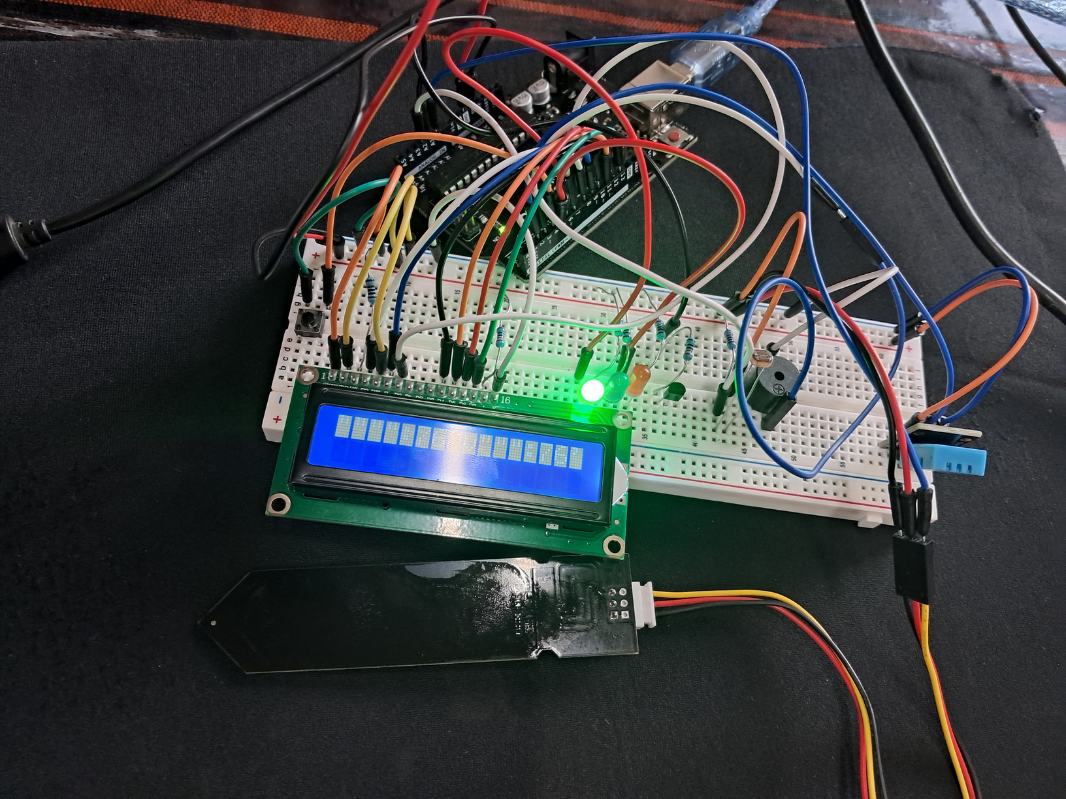
CCN
PROJECT
INNOVATION
This open system stands out for its ability to monitor temperature and humidity through sensors, setting it apart from conventional school projects. It analyzes terrestrial date so identify specific climatic changes, providing accurate and localized information.
NicoNautas

Slide 5

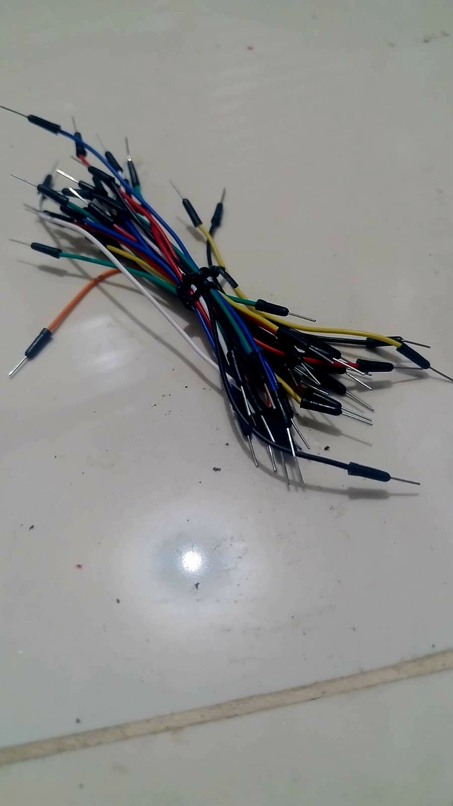
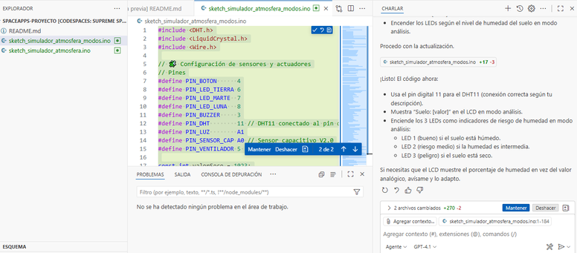
https://github.com/STMARCO414/spaceapps-proyecto
CCN
USE OF ARTIFICIAL INTELLIGENCE
COPILOT
GitHub
It is used to optimize the connections of the jumper wires, ensuring efficient assembly.
It facilitates version control and collaborative editing of the project´s code.
Access link to the code
https://github.com/STMARCO414/spaceapps-proyecto
NicoNautas

Slide 6
CCN
PROJECT OBJECTIVES
To measure the main environmental variables, including humidity, temperature, gases, pressure, and radiation.
To visualize date in real time through and LCD screen, including simple alerts.
To compare atmospheric conditions across different physical or planetary environments.
To document the behavior of the sensors to facilitate their educational use and replicability.
To foster technical skills in hardware integration and date analysis.
NicoNautas

Slide 7
CCN
PROCESSES
CONCLUSION
We seek ideas.
We plan.
We obtained the necessary resources.
We began the documentation and established the necessary connections.
Afterwards, we carried out the necessary programming adjustments.
The project has made considerable progress in climate assessment, identifying problems and solutions that strengthen analytical capacity for future challenges.
NicoNautas

